Slide 1
Penambahbaikan Teknik Pengekstrakan Fitur
Untuk Klasifikasi Penjagaan Kesihatan
Bedasarkan Mesin Vektor Sokongan (SVM)
Disediakan Oleh:
Mustazzihim Suhaidi
[P100520]
Penyelia :
Prof. Madya Dr. Rabiah Binti Abdul Kadir
Dr. Sabrina Tiun

Slide 2
Progress Report
Apply text-processing and provide table to shows the impact of text-processing towards Word Embedding (pengurangan dimensi)
Apply Word Embedding method and Provide table of comparable between method of WE using measurement unit (untuk melihat kesan ke atas dimensi)
Proposal Defense
Apply Word Embedding method and Provide table of comparable between method of WE guna F-measure (untuk melihat ketepatan klasifikasi)
Analisis experiment

Slide 3
Apply text-processing
YEAR | TITLE PAPER | PRE-PROCESSING TECHNIQUES
2022 | Citation Context Analysis Using Combined Feature Embedding and Deep Convolutional Neural Network Model | Punctuation Removal, Stopword Removal, Numeric values removal, Stemming, Tokenization
2021 | Investigating the impact of pre‐processing techniques and pre‐trained word embeddings in detecting Arabic health information on social media | Tokenization, Noise removal, Normalization, Arabic‐specific normalization, Removing stop words, Stemming
2021 | Word embedding and text classification based on deep learning methods | Stop Words Removed, Tokenization
2021 | The Effect of Preprocessing Techniques, Applied to NumericFeatures, on Classification Algorithms’ Performance | Normalization, Discretization, Transformation, Handling Missing Values
2019 | Impact of Preprocessing Methods on Healthcare Predictions | Integration, Cleaning, Normalization, Scaling, Reduction Techniques
2019 | The Impact of Data Pre-Processing Techniques and Dimensionality Reduction one the Accuracy of Machine Learning | Normalization, Discretization, Dimensionality Reduction
2018 | The impact of preprocessing steps on the accuracy of machine learning algorithms in sentiment analysis | Removal of emoticons, Removal of stopwords, Stemming, Word vectorization

Slide 4
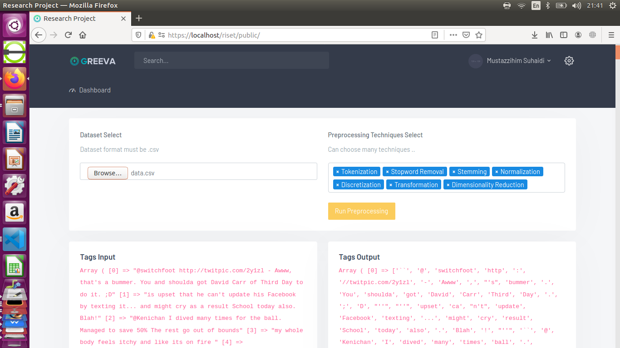
Experiment

Slide 5
Publish

Slide 6
Next Semester Plan
Apply text-processing and provide table to shows the impact of text-processing towards Word Embedding (pengurangan dimensi)
Apply Word Embedding method and Provide table of comparable between method of WE using measurement unit (untuk melihat kesan ke atas dimensi)
Next Plan
Apply Word Embedding method and Provide table of comparable between method of WE guna F-measure (untuk melihat ketepatan klasifikasi)

Slide 7
Thank you
Terimakasih

